Slide 1


MASTER’S DEGREE IN COMPUTER ENGINEERING
INDUSTRIAL APPLICATIONS
PROJECT DISCUSSION
MoodPilot
(
PROFESSORS
PROTOTYPE
PRESENTATION
STUDENTS
PIERFRANCESCO FOGLIA
ANTONIO COSIMO PRETE
GIOVANNI LIGATO GIUSEPPE SORIANO
University of Pisa

Slide 2
ABSTRACT
In this study, we present a system for evaluating user satisfaction with autonomous and manual driving experiences through Facial Expression Recognition (FER). A detailed analysis was conducted to identify and benchmark state-of-the-art FER models, including DeepFace, EmoNet, HSEmotionONNX, RMN, and Vision Transformer (ViT), with additional tests performed on a Raspberry Pi 3B+ as a reference for potential car controller deployment. Alongside this analysis, we developed a frontend and backend system to facilitate data collection for future training of a predictive model. The system allows users to manually respond to a form and undergo video-based analysis of their driving experience. The ultimate goal is to train a model that can autonomously infer user responses based on collected data, paving the way for an adaptive system to evaluate driving satisfaction efficiently.

Slide 3
Facial Expression Recognition in Automotive Applications
Role of Emotions: Fundamental in shaping human behavior, cognition, and decision-making.
Relevance in Driving: Key to evaluating passenger satisfaction in autonomous and manual driving modes.
System Overview: Automates emotion-based passenger experience analysis for ride-hailing and driving services, enhancing service quality and user trust.
Key Technology: Facial Expression Recognition (FER) for real-time emotional state assessment.
Challenges: Addressing in-car constraints like limited resources, environmental variability, and privacy.
INTRODUCTION

Slide 4








RATING
FACIAL
EXPRESSION
RECOGNITION
PASSENGER
DRIVER
FACIAL EXPRESSION RECOGNITION
INTEGRATION
AUTO-FILLED FEEDBACK FORMS
EMOTION-BASED
Notes:
Didi Chuxing implementa il monitoraggio telemetrico della guida (algoritmo di machine learning per verificare frenate brusche, accelerazioni brusche e altri parametri che definiscono una guida pericolosa.

Slide 5



TWO-WAY RATING SYSTEMS FOR DRIVER EVALUATION
EFFECTIVENESS IN ASSESSING DRIVER PERFORMANCE
[1]
PLATFORM-MEDIATED REPUTATION SYSTEMS IN THE SHARING ECONOMY (2020)
Analyzes how platform-driven reputation systems impact service quality in ride-sharing, highlighting benefits and limitations in maintaining consistent quality.
[2]
A SYSTEMATIC LITERATURE REVIEW OF RIDE-SHARING PLATFORMS, USER FACTORS, AND BARRIERS (2021)
STATE OF THE ART
Provides a systematic review of ride-sharing platforms, focusing on user adoption factors and barriers, including the effectiveness of rating systems.
[3]
UNDERSTANDING RIDE-SHARING SYSTEMS IN URBAN AREAS: LOCATION, USERS, AND BARRIERS (2020)
Explores ride-sharing in urban areas, examining the role of location, user types, and system barriers with specific reference to two-way rating mechanisms.
Notes:
Didi Chuxing implementa il monitoraggio telemetrico della guida (algoritmo di machine learning per verificare frenate brusche, accelerazioni brusche e altri parametri che definiscono una guida pericolosa.

Slide 6

FACIAL EXPRESSION RECOGNITION IN AUTOMOTIVE CONTEXTS
ENHANCEMENT OF PASSENGER SAFETY AND EXPERIENCE
[4]
DRIVER EMOTION RECOGNITION FOR INTELLIGENT VEHICLES: A SURVEY (2020)
Provides a comprehensive literature survey of work addressing the problem of human emotion recognition in an automotive context.
[5]
AUDIOVISUAL AFFECT RECOGNITION FOR AUTONOMOUS VEHICLES: APPLICATIONS, CHALLENGES, AND OPPORTUNITIES (2023)
STATE OF THE ART
Examines the use of audiovisual emotion recognition in autonomous vehicles, highlighting technical challenges and opportunities for improving human-machine interaction.
[6]
REVIEW AND PERSPECTIVES ON HUMAN EMOTION FOR CONNECTED AUTOMATED VEHICLES (2023)
Discusses the importance of recognizing human emotions in connected automated vehicles, focusing on implications for passenger safety and experience.
Notes:
Didi Chuxing implementa il monitoraggio telemetrico della guida (algoritmo di machine learning per verificare frenate brusche, accelerazioni brusche e altri parametri che definiscono una guida pericolosa.

Slide 7

FACIAL EXPRESSION RECOGNITION ON EDGE DEVICES
PRIVACY-PRESERVING AND REAL-TIME EMOTION DETECTION
[7]
USING EMOTION RECOGNITION AND TEMPORARY MOBILE SOCIAL NETWORK IN ON-BOARD SERVICES FOR CAR PASSENGERS (2023)
Deployment of FER Systems on Edge Devices Using Raspberry Pi: Evaluates the performance of lightweight FER systems on resource-constrained edge devices, emphasizing their potential for privacy-sensitive and real-time applications.
Lightweight Models for FER: Highlights the efficiency of lightweight FD and FER models like Yoloface-500k v2 and DeepFace for achieving real-time emotion detection on edge devices.
Accelerated FER Using Neural Compute Stick 2: Discusses how NCS2 accelerators significantly enhance FER processing speeds, enabling efficient deployments for in-car systems in constrained environments.
STATE OF THE ART
Notes:
Didi Chuxing implementa il monitoraggio telemetrico della guida (algoritmo di machine learning per verificare frenate brusche, accelerazioni brusche e altri parametri che definiscono una guida pericolosa.

Slide 8





DATABASE
CAR CONTROLLER
BACK-END
SYSTEM
ARCHITECTURE
FRONT-END
MOBILE APP

Slide 9





DATABASE
CAR CONTROLLER
BACK-END
SYSTEM
ARCHITECTURE
Pilot
FRONT-END
MOBILE APP

Slide 10

FER DEPLOYMENT ON AN EDGE DEVICE
THE PROTOTYPE
DATA COLLECTION SYSTEM

Slide 11
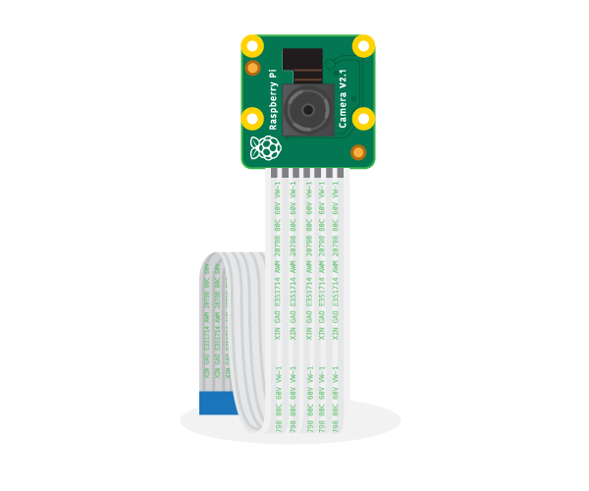
HARDWARE SETUP
RASPBERRY PI 3 MODEL B+
Processor: 1.4GHz 64-bit quad-core Broadcom BCM2837B0, Cortex-A53 (ARMv8) SoC.
Memory: 1GB LPDDR2 SDRAM.
Wireless Connectivity: Dual-band 2.4GHz and 5GHz IEEE 802.11.b/g/n/ac wireless LAN, Bluetooth 4.2/BLE.
GPIO: Extended 40-pin GPIO header.
Camera Support: CSI camera port for connecting a Raspberry Pi camera.
Power Input: 5V/2.5A DC power input.
RASPBERRY PI CAMERA MODULE (V2.1)
Sensor: Sony IMX219, 8-megapixel sensor.
Capabilities:
High-definition video recording: 1080p30, 720p60, VGA90 video modes.
Still image capture.
Connection: Attaches via a 15cm ribbon cable to the CSI port on the Raspberry Pi.
Software Support: Numerous third-party libraries are available, including the Picamera Python library.

Slide 12
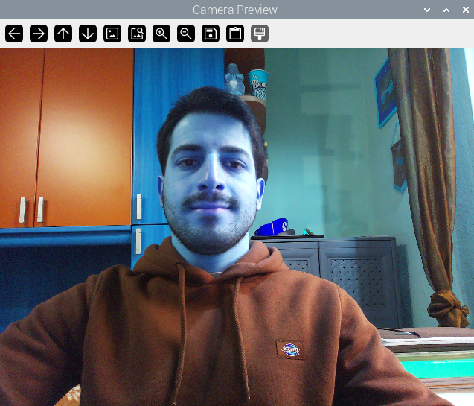
RASPBERRY PI CAMERA INTEGRATION
picamera2
OpenCV
pi@raspberrypi: ~/Progetto_IndustrialApplications $ python3 Prototype/FER/camera.py

Slide 13

EMOTION DETECTION DEPLOYMENT
OpenCV
FRAME
FACE DETECTOR
OpenCV
HAAR CASCADE
HSEmotionONNX
8 EMOTION CLASSES
(16 MB)
FACIAL EXPRESSION RECOGNITION

Slide 14

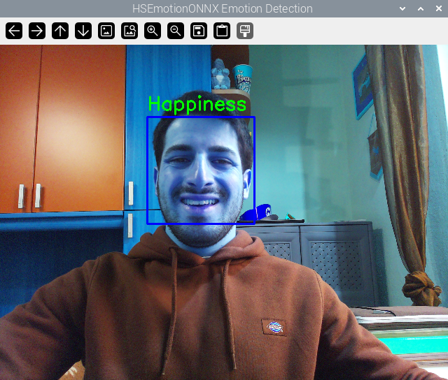
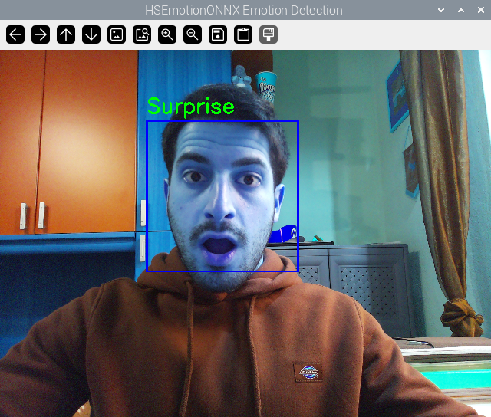
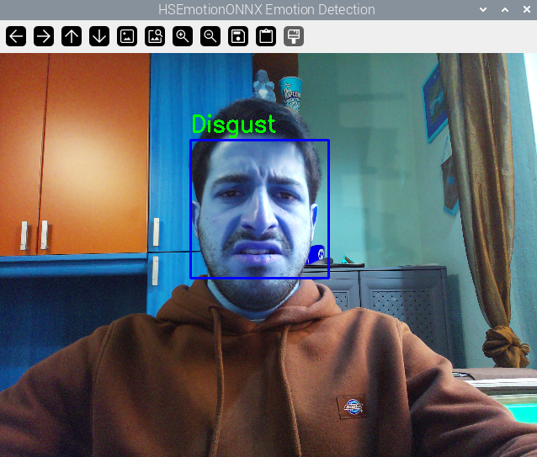
REAL-TIME EMOTION DETECTION
pi@raspberrypi: ~/Progetto_IndustrialApplications/Prototype/FER/Models/HSEmotionONNX $ python3 hsemotion_onnx.py

Slide 15


WHAT ABOUT PERFORMANCE?
~0.50
~0.90
FPS
FPS
WITH PREVIEW
WITHOUT PREVIEW
HSEmotionONNX
+
RASPBERRY PI 3B+
+
RASPBERRY PI OS
(DEBIAN 12 – 64 BIT)
=

Slide 16


CAPTURING EMOTIONS
AND
USER FEEDBACK FOR MODEL TRAINING
The system was designed to capture passengers' emotional states and feedback during rides, creating a robust dataset for analysis. It integrates:
Frontend module for user interaction.
Backend module for data processing and storage.
THE DATA COLLECTION SYSTEM
FUTURE DEVELOPMENT
The collected dataset will enable training of predictive models capable of autonomously answering feedback form questions based on passengers’ inferred emotions. This feature bridges the gap between user feedback and adaptive driving systems, enabling real-time evaluations and adjustments to improve ride quality.

Slide 17


BACKEND MODULE
DATABASE
MONGODB
Processes video inputs using AI-based emotion detection models.
Stores emotional data and feedback securely in a structured database.
Includes a robust API layer for efficient data exchange and future model integration.
BACK-END
FLASK

Slide 18



FRONTEND MODULE
Passengers complete a feedback form about their driving experience after their facial expressions are recorded in real-time during the ride. This data provides insights into user emotions and overall satisfaction.
FRONT-END
ANGULAR
WEB APP

Slide 19
DATA COLLECTION SYSTEM
DATABASE
MONGODB
CAR CONTROLLER
RASPBERRY PI 3B+
FER DEPLOYMENT ON AN EDGE DEVICE
BACK-END
FLASK
MODULES
ALLOCATION
FRONT-END
WEB APP

Slide 20
REFERENCES
[1]
PLATFORM-MEDIATED REPUTATION SYSTEMS IN THE SHARING ECONOMY (2020)
https://www.academia.edu/77030822/Platform_mediated_reputation_systems_in_the_sharing_economy_and_incentives_to_provide_service_quality_the_case_of_ridesharing_services
[2]
A SYSTEMATIC LITERATURE REVIEW OF RIDE-SHARING PLATFORMS, USER FACTORS, AND BARRIERS (2021)
https://etrr.springeropen.com/articles/10.1186/s12544-021-00522-1
[3]
UNDERSTANDING RIDE-SHARING SYSTEMS IN URBAN AREAS: LOCATION, USERS, AND BARRIERS (2020)
https://www.academia.edu/76607239/Understanding_Ride_Sharing_Systems_in_Urban_Areas_The_Role_of_Location_Users_and_Barriers
[4]
DRIVER EMOTION RECOGNITION FOR INTELLIGENT VEHICLES: A SURVEY (2020)
https://www.media.mit.edu/publications/driver-emotion-recognition-for-intelligent-vehicles-a-survey/
Notes:
Didi Chuxing implementa il monitoraggio telemetrico della guida (algoritmo di machine learning per verificare frenate brusche, accelerazioni brusche e altri parametri che definiscono una guida pericolosa.

Slide 21
REFERENCES
[5]
AUDIOVISUAL AFFECT RECOGNITION FOR AUTONOMOUS VEHICLES: APPLICATIONS, CHALLENGES, AND OPPORTUNITIES (2023)
https://ieeexplore.ieee.org/document/10337780
[6]
REVIEW AND PERSPECTIVES ON HUMAN EMOTION FOR CONNECTED AUTOMATED VEHICLES (2023)
https://link.springer.com/article/10.1007/s42154-023-00270-z
[7]
USING EMOTION RECOGNITION AND TEMPORARY MOBILE SOCIAL NETWORK IN ON-BOARD SERVICES FOR CAR PASSENGERS (2023)
https://link.springer.com/chapter/10.1007/978-3-031-37470-8_7
Notes:
Didi Chuxing implementa il monitoraggio telemetrico della guida (algoritmo di machine learning per verificare frenate brusche, accelerazioni brusche e altri parametri che definiscono una guida pericolosa.

Slide 22


TOOLS
coolors.co/palette/f9dbbd-fca17d-da627d-9a348e-0d0628
www.flaticon.com
Notes:
Didi Chuxing implementa il monitoraggio telemetrico della guida (algoritmo di machine learning per verificare frenate brusche, accelerazioni brusche e altri parametri che definiscono una guida pericolosa.

Slide 23
THANKS
FOR YOUR ATTENTION

